Slide 1
ECE314 Lab 7 Overview
Intro to Markov chains
Markov Gibberish
Random graphs

Slide 2

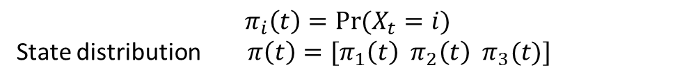


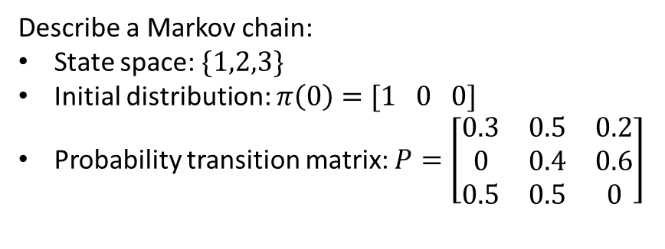



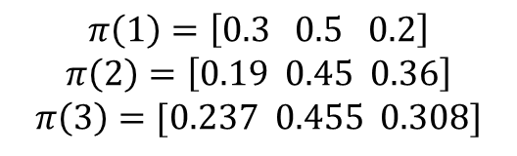

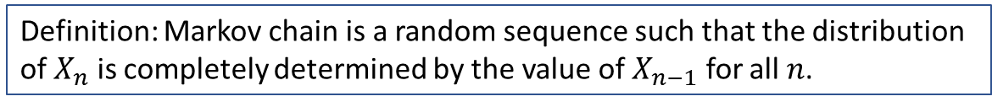


Markov chain
$$X_{1}$$
$$X_{2} X_{3} X_{4} X_{5} X_{6} X_{7} X_{8} X_{9} X_{10} ⋯$$
Definition: Markov chain is a random sequence such that the distribution of $X_{n}$ is completely determined by the value of $X_{n−1}$ for all $n$.
$$π_{i}\left(t\right)=\operatorname{Pr}{(X_{t}=i)}$$
State distribution $π\left(t\right)=[π_{1}\left(t\right) π_{2}\left(t\right) π_{3}(t)]$
$$0.3$$
1
Describe a Markov chain:
State space: $\{1,2,3\}$
Initial distribution: $π\left(0\right)=[1 0 0]$
Probability transition matrix: $P=\left[\begin{matrix}0.3 & 0.5 & 0.2 \\ 0 & 0.4 & 0.6 \\ 0.5 & 0.5 & 0\end{matrix}\right]$
$$0.5$$
$$0.5$$
$$0.2$$
3
$$0.5$$
2
$$0.6$$
$$0.4$$
$$π\left(t\right)=π\left(t−1\right) P$$
$$π\left(1\right)=\left[0.3 0.5 0.2\right]$$
$$π\left(2\right)=\left[0.19 0.45 0.36\right]$$
$$π\left(3\right)=[0.237 0.455 0.308]$$

Slide 3







Markov Gibberish
Once when I was six years old I saw a magnificent picture in a book, called True Stories from Nature, about the primeval forest. It was a picture of a boa constrictor in the act of swallowing an animal. Here is a
copy of the drawing.
In the book it said: "Boa constrictors swallow their prey whole, without chewing it. After that they are not able to move, and they sleep through the six months that they need for digestion."
I pondered deeply, then, over the adventures of the jungle. And after some work with a colored pencil I succeeded in making my first drawing. My Drawing Number One. It looked something like this:
I showed my masterpiece to the grown-ups, and asked them whether the drawing frightened them.
But they answered: "Frighten? Why should any one be frightened by a hat?“
…
-- The Little Princess
$$w_{1}$$
$$w_{2}$$
$$w_{3}$$
$$w_{4}$$
$$w_{5}$$
$$w_{6}$$
Markov chain: $w_{1}w_{2}, w_{2}w_{3}, w_{3}w_{4}, ⋯$

Slide 4
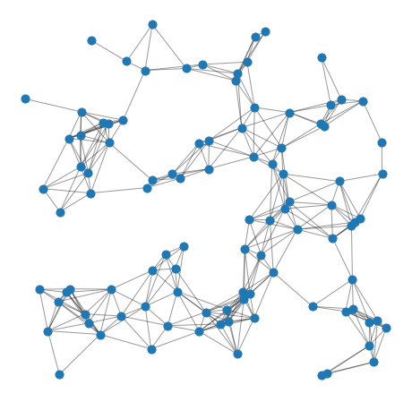




Random graphs
$$1$$
n: number of nodes
d: distance threshold
$$\operatorname{Pr}\left(connected\right)= ?$$
$$0$$
$$1$$

